Slide 1
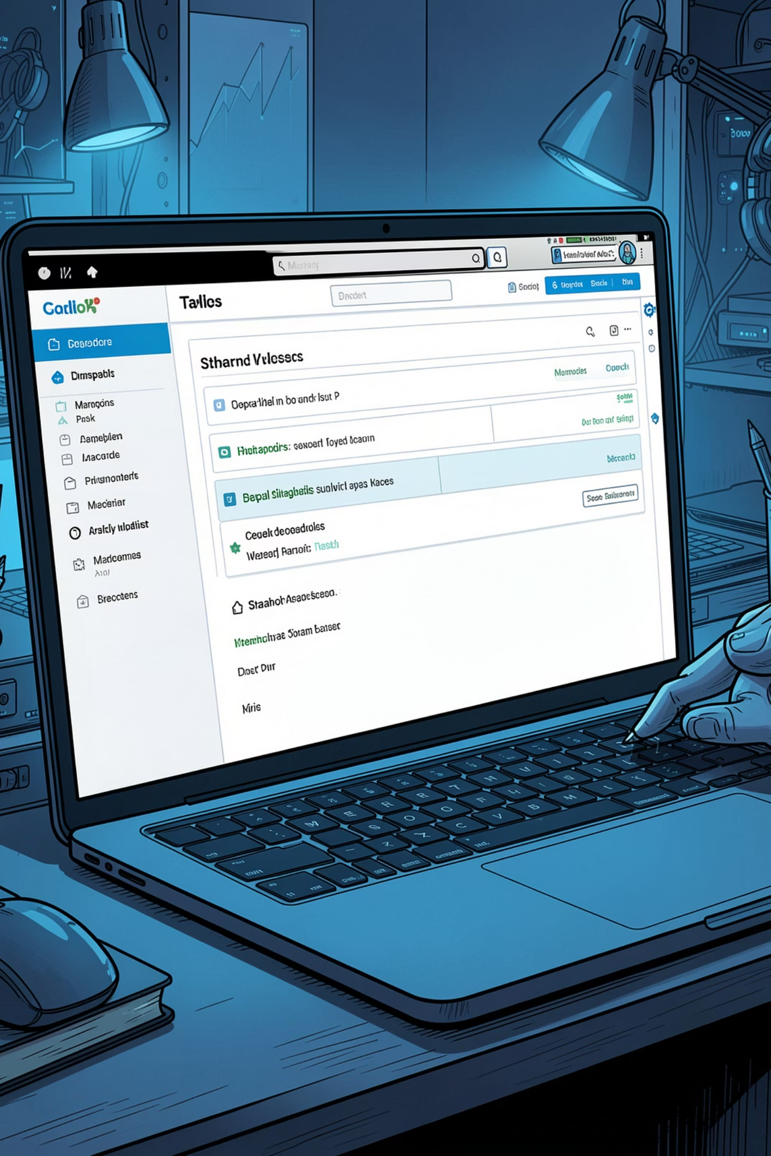
Taskflow Live
Project progress report — installation, logs, milestones & app overview
MAY 2026

Slide 2
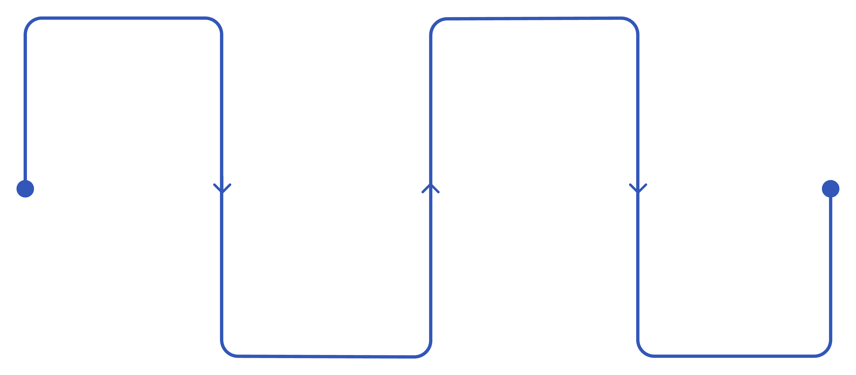
Installation
Clone the repo
Start
Download the GitHub repository
NPM scripts: ‘start’ and ‘dev’
Open in VS Code
Open the link
Open the terminal address in the browser
Load the frontend and backend
The project is cloned via GitHub. The frontend and backend are opened in Visual Studio Code and started using the NPM scripts “start" and “dev". The link address shown in the terminal is opened in the browser.

Slide 3
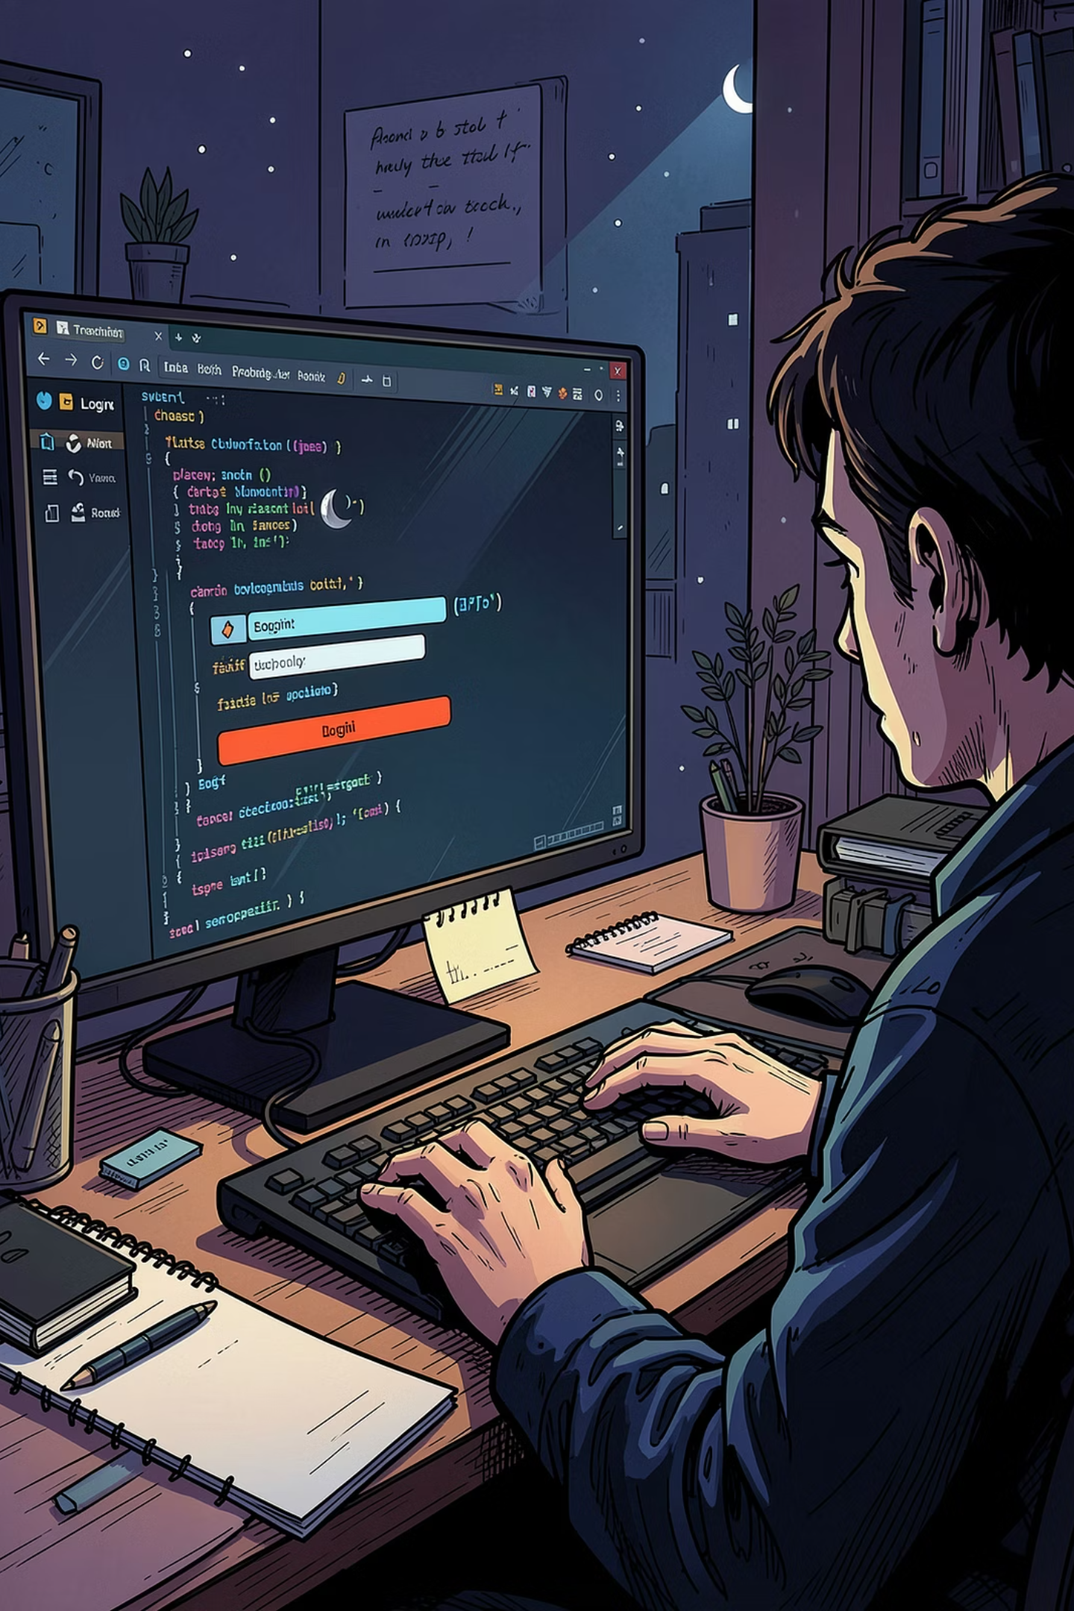
Protocol 1 — May 21, 2026
What was done?
Timeline
Login & Register pages developed. Backend endpoints created, frontend design implemented according to mockups. Style, error handling & bug fixes developed with Gemini CLI.
As of 20/5/2026: On schedule — All tasks due by 21/5/2026 were completed.
Next steps
Dashboard with dummy data, profile/settings page, team management, and i18n language translation.

Slide 4
Protocol 2 — 27 May 2026
Dashboard View
Backend & AI
Next 3 tasks as a list
Task priority as a pie chart
Task overview statistics
Task progress as a line chart
Endpoints for charts, statistics & user settings created. DB seeder expanded for more tasks.
AI: Gemini CLI — direct filesystem access made the work easier. Bug fixes & design updates implemented through targeted prompts.
Settings View
Show, edit & delete user info
Language Switching
EN/DE button in the taskbar — language is saved & loaded on the next login.

Slide 5
Schedule Status
✅ Week 1
⚠️ Week 2
⚠️ Week 3
Foundation & Auth — implemented without issues
Team management was overlooked → moved to Week 3
Drag & Drop moved to Week 5; will be replaced with buttons
✅ Week 4
❌ Week 5
Implemented without issues
Planning error — only 4 weeks available

Slide 6
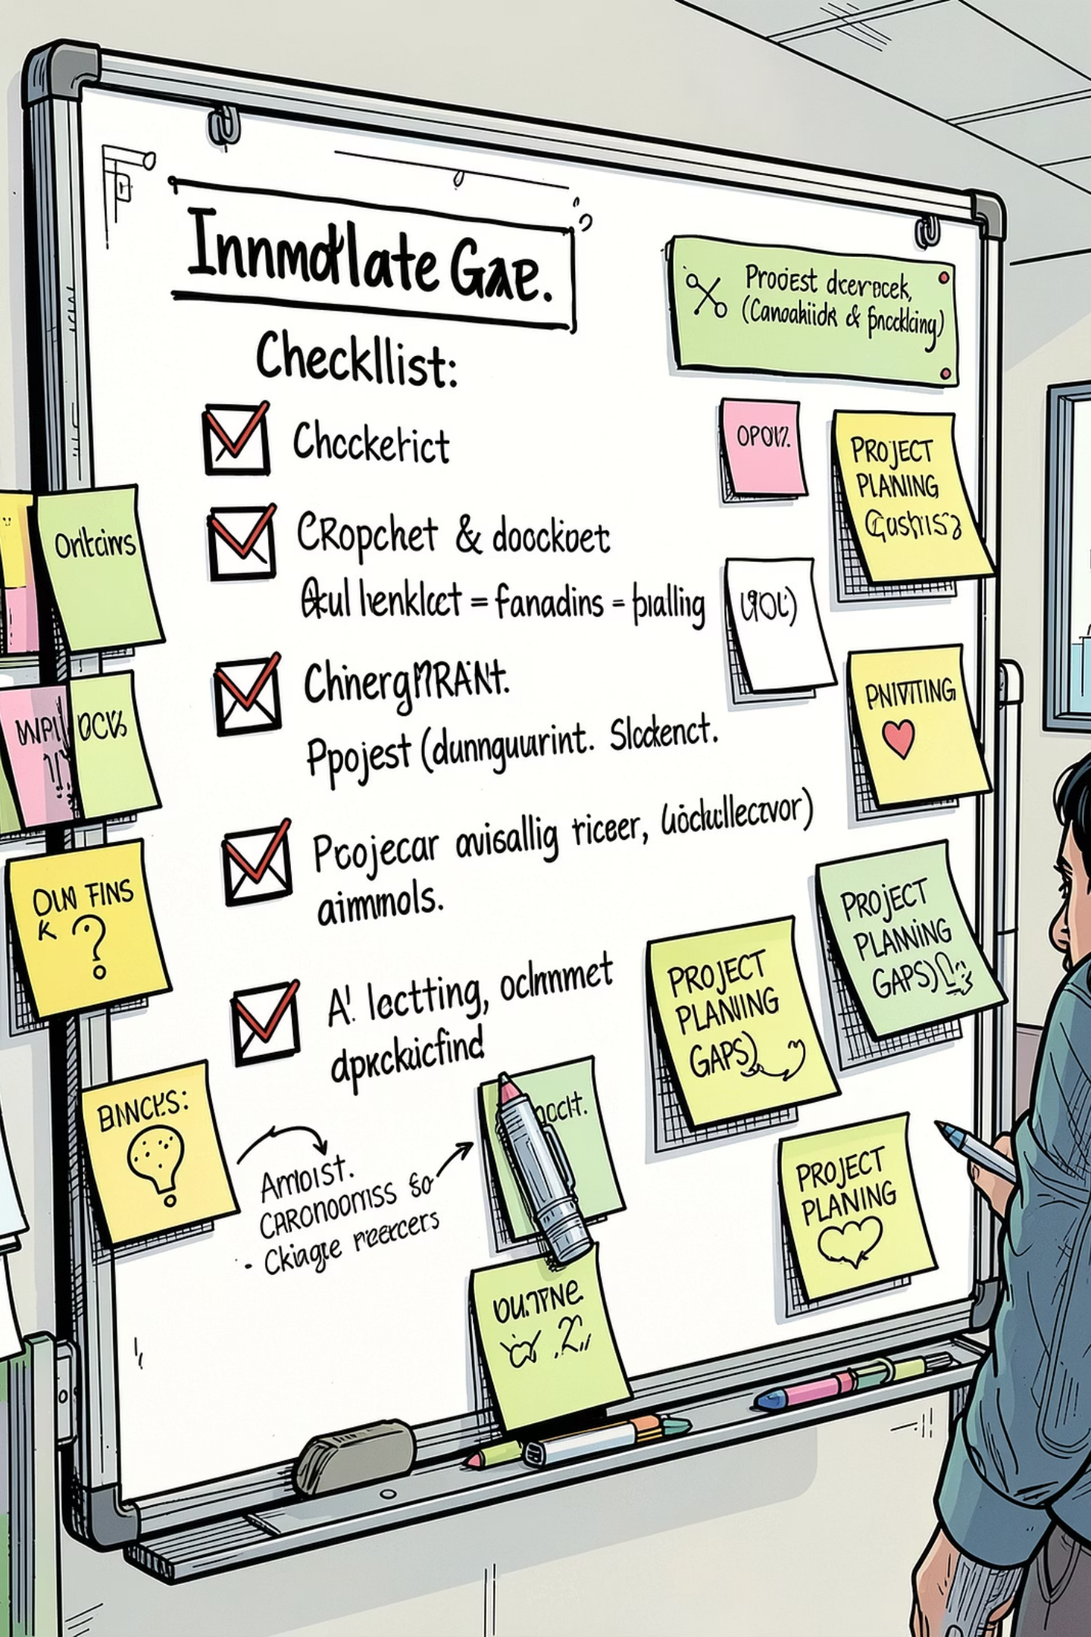
Missing Features
Avatar Update
The avatar in the lower-left area of the website is not updating.
Filter, Sort & Search
Buttons/bars for filtering, sorting, and search are missing in the Project and Task views.
Drag & Drop
Drag & drop functionality for tasks is missing — it will be replaced by buttons.
Project View Progress
The progress bar in the Project View is static.

Slide 7
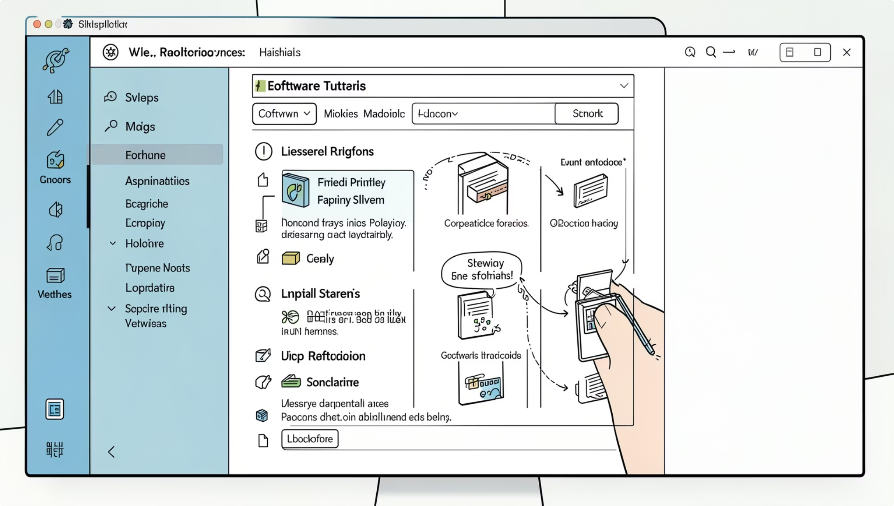

Using the App — Scribe
📎 Link to the instructions:
Managing Projects and Team Tasks in the Dashboard

Slide 8
Screenshots

Slide 9
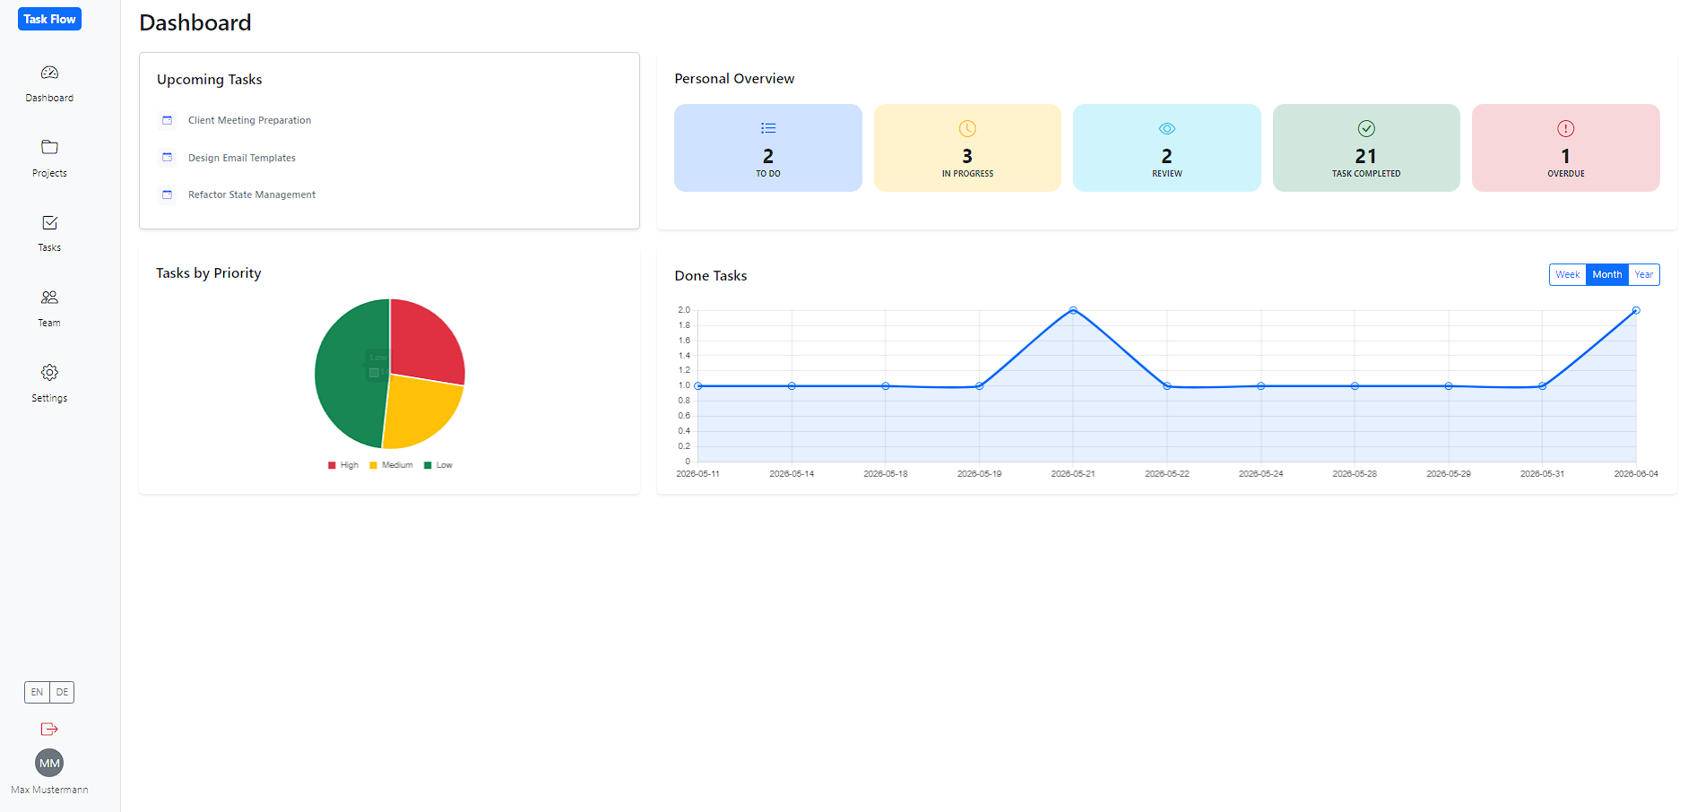

Slide 10
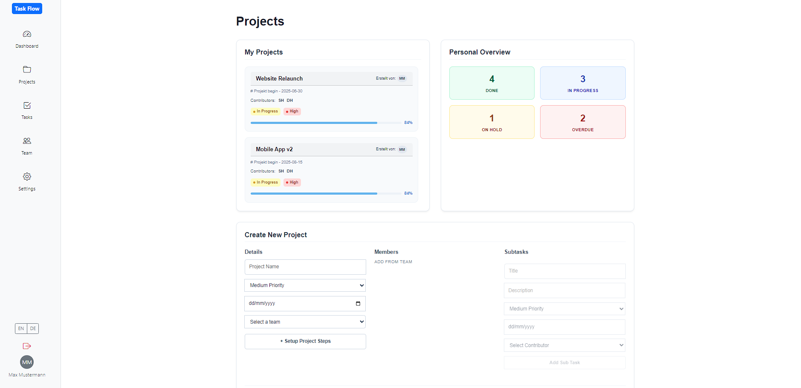

Slide 11
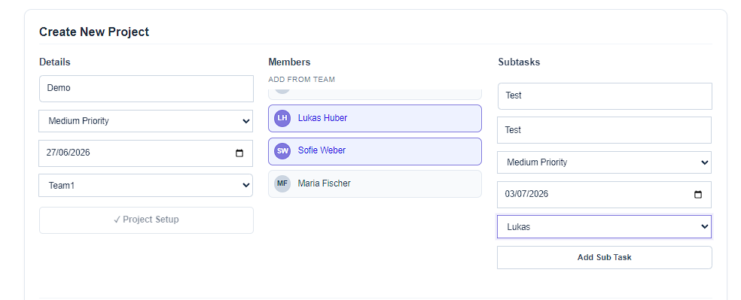

Slide 12
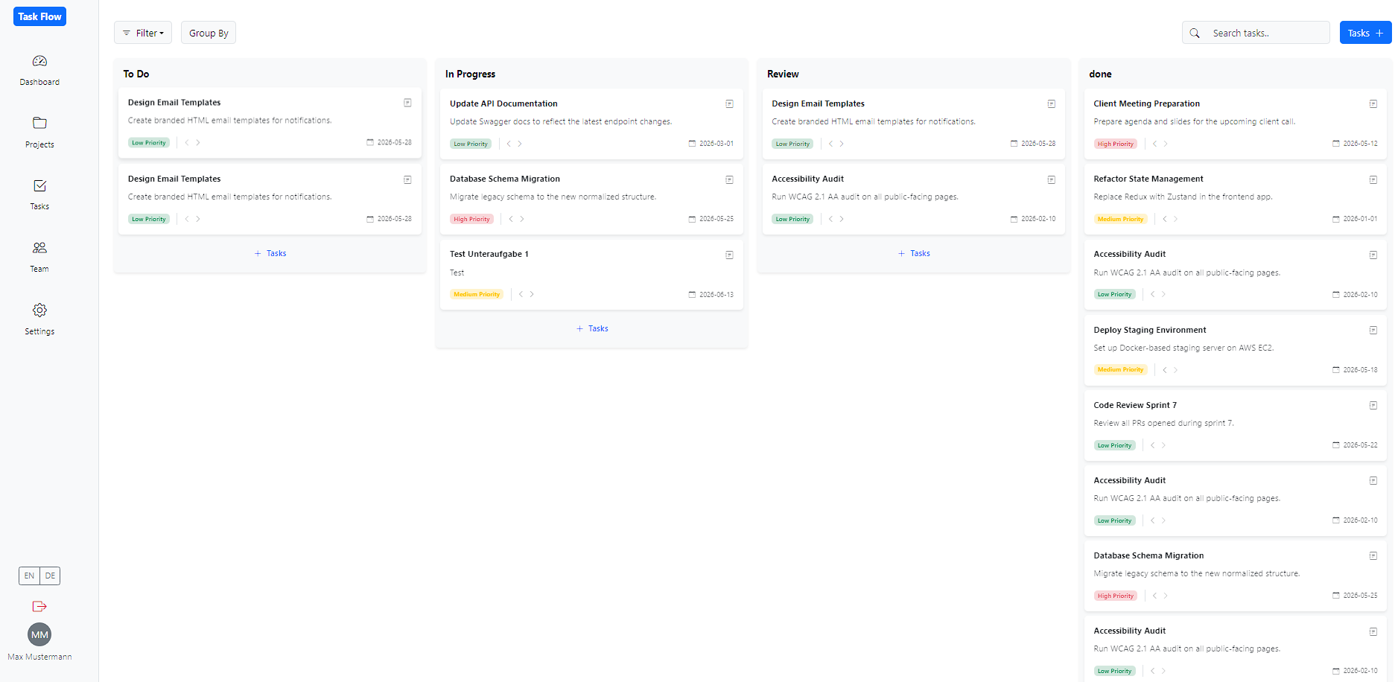

Slide 13
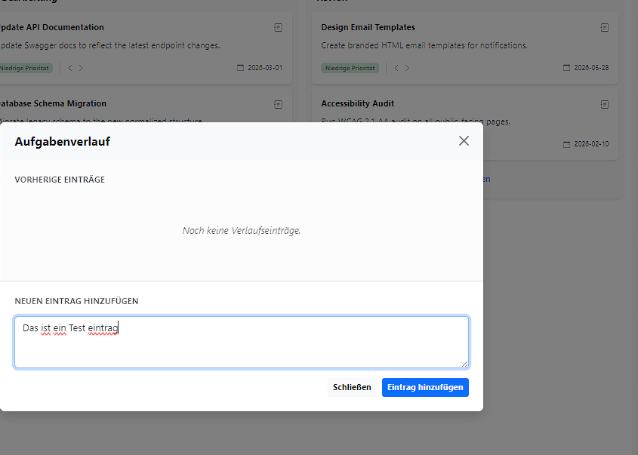

Slide 14
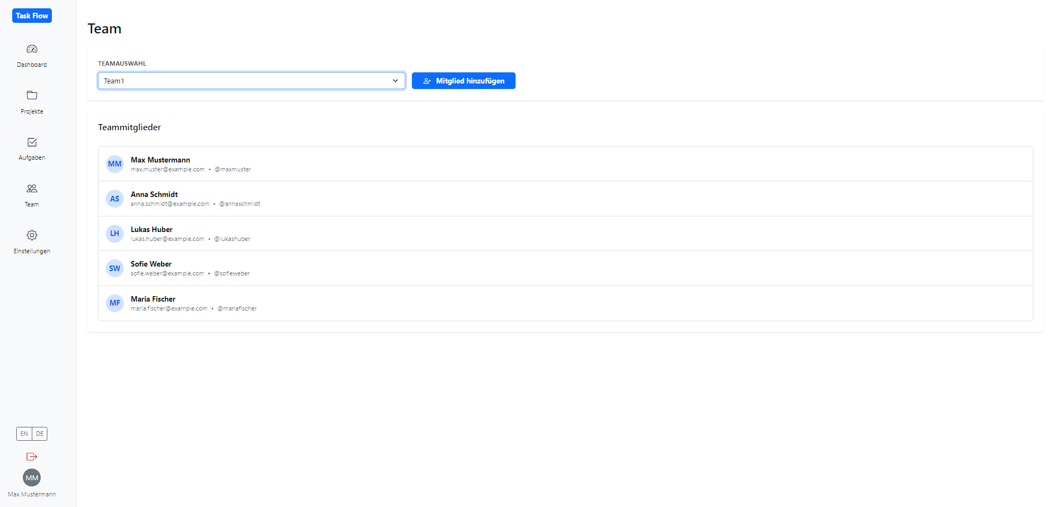

Slide 15
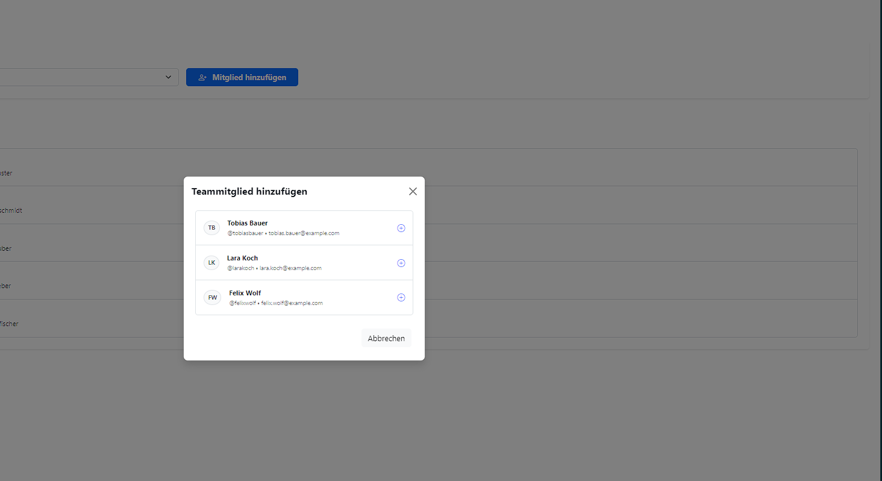

Slide 16
